Slide 1

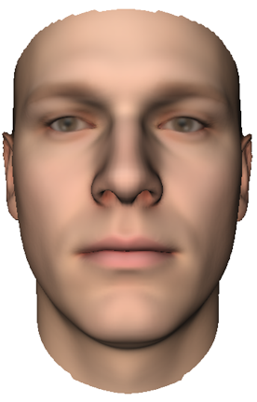
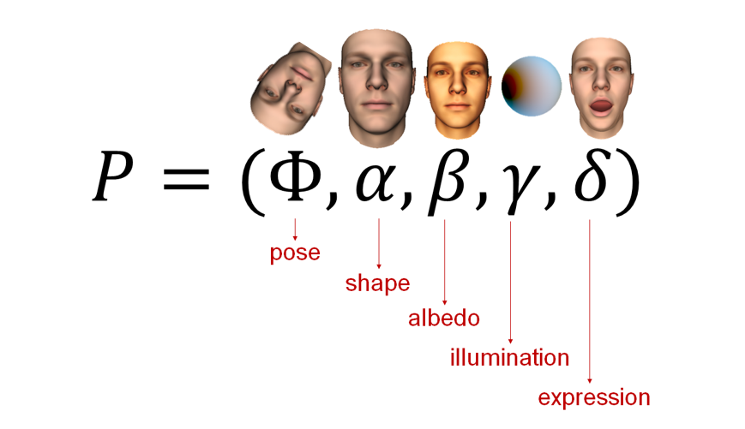
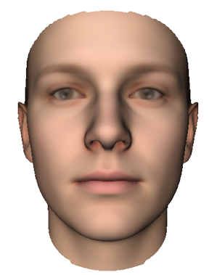
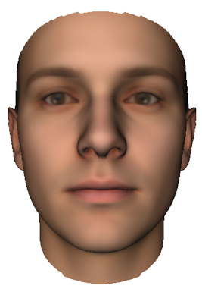
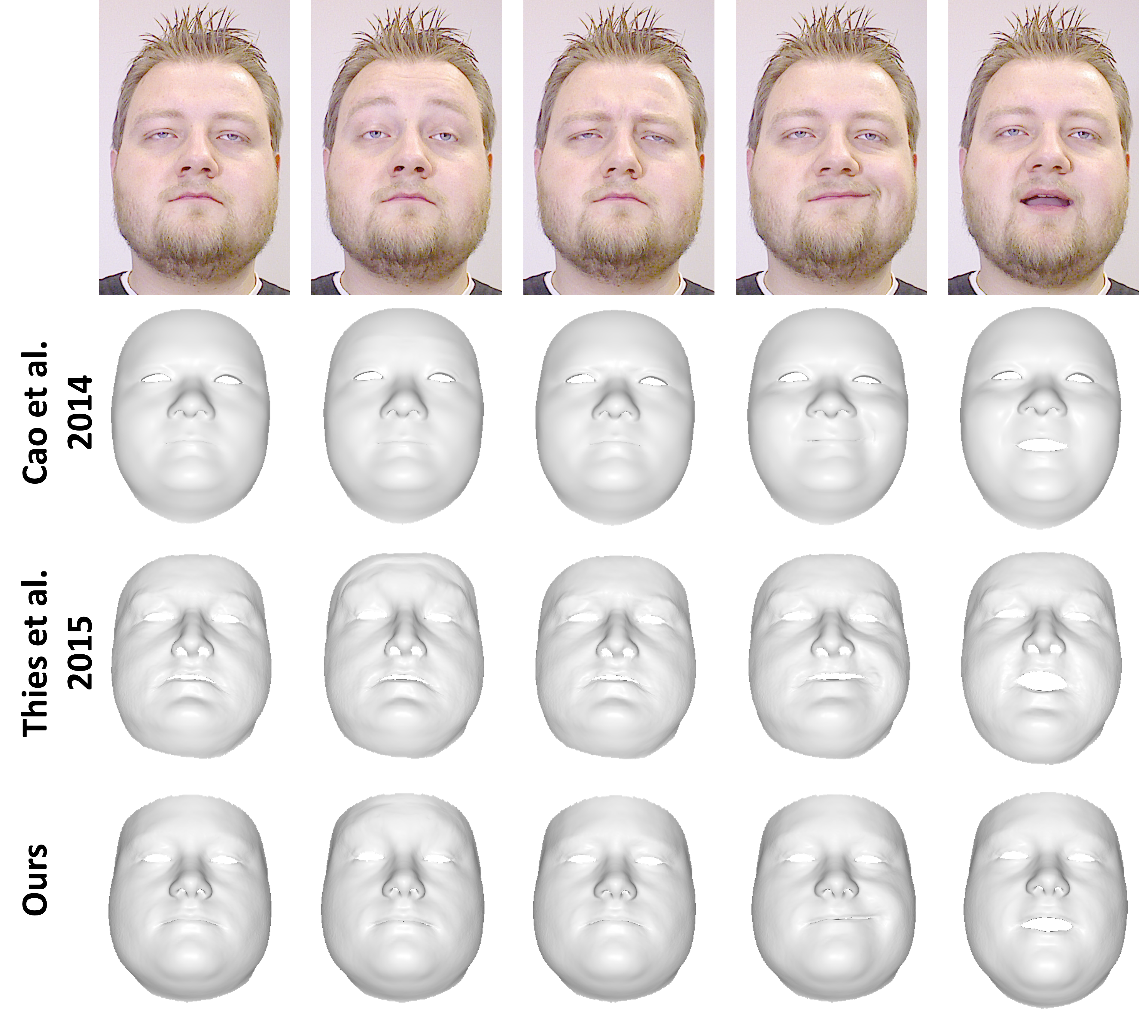
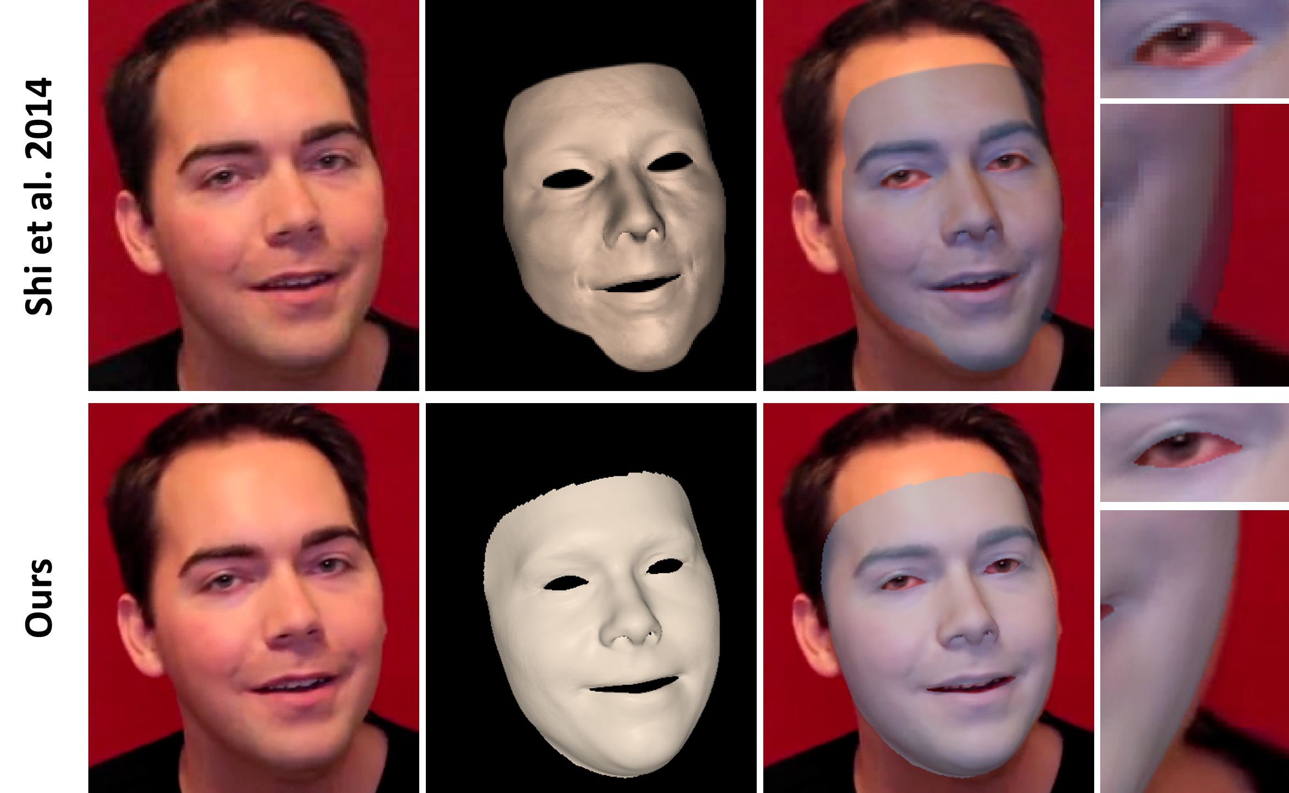
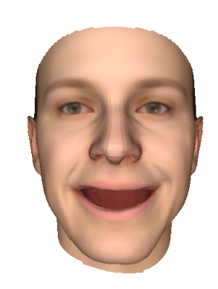
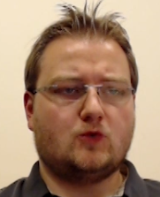
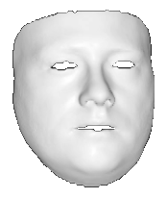
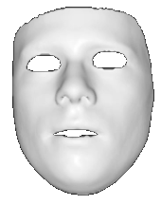
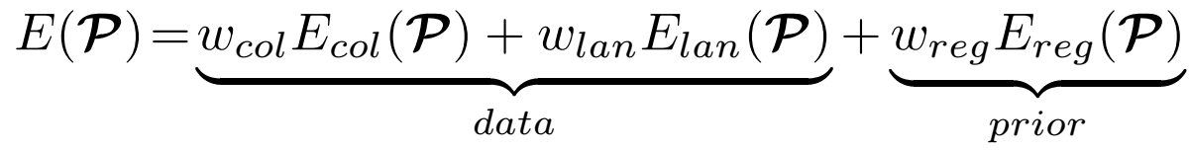
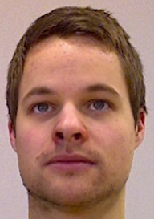
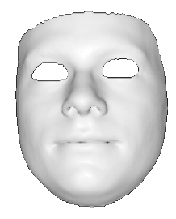
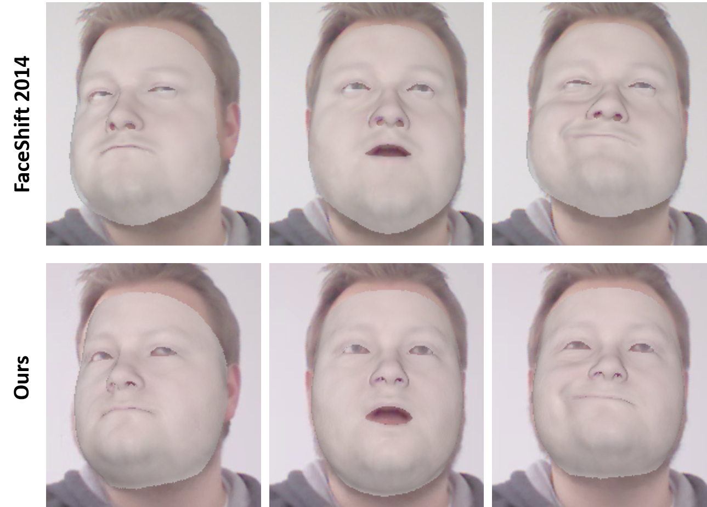
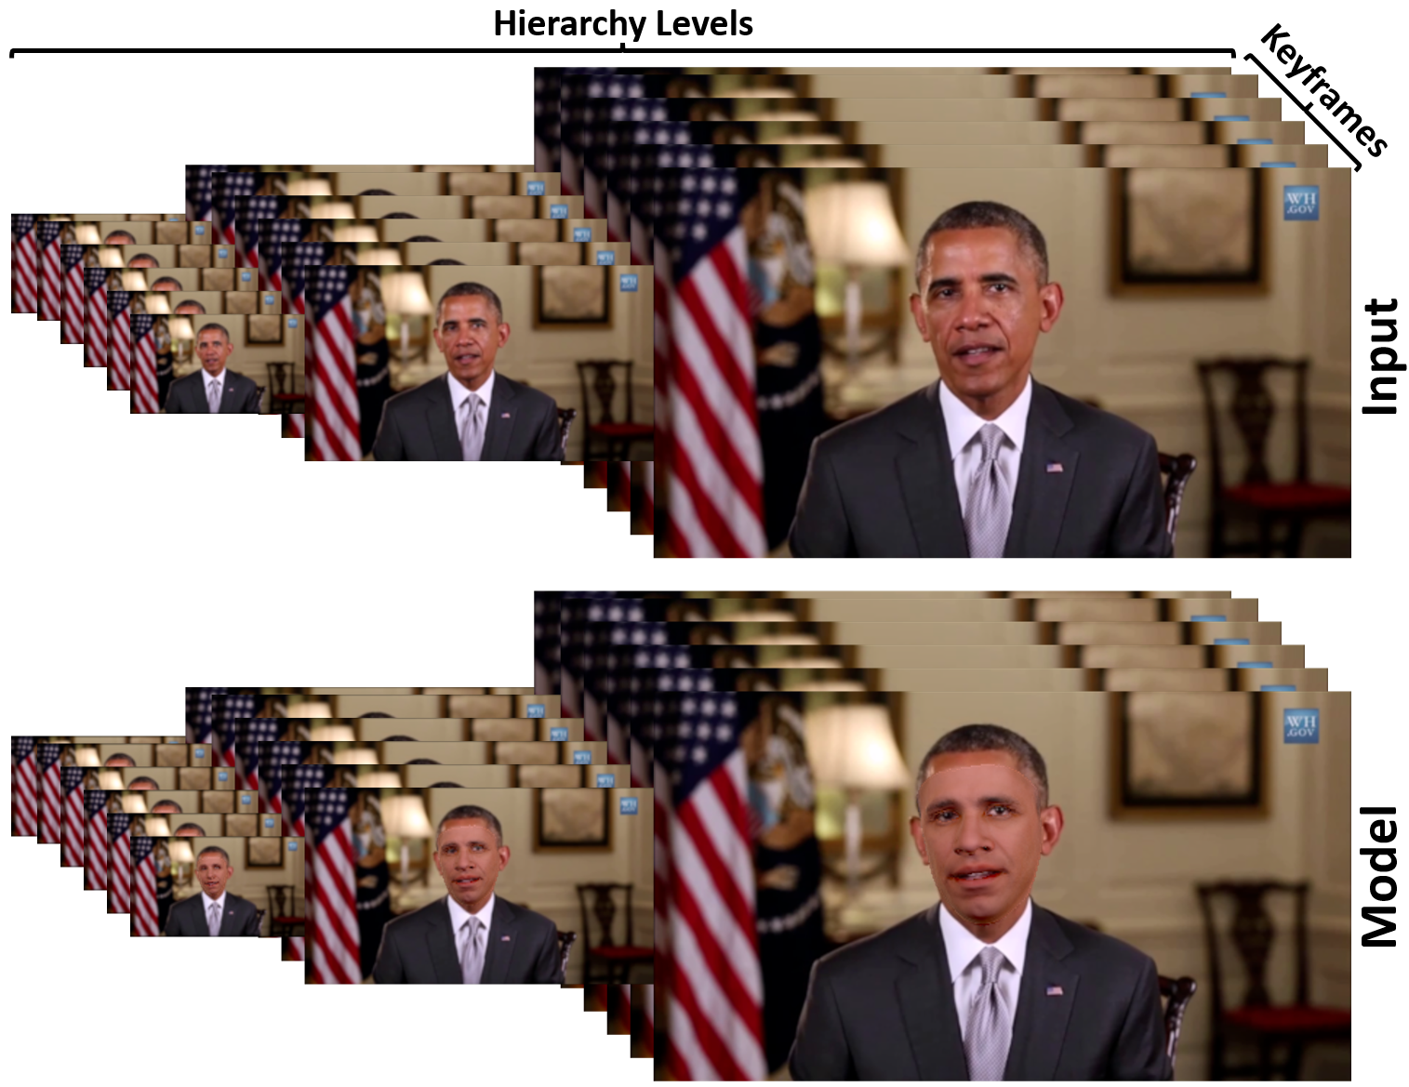
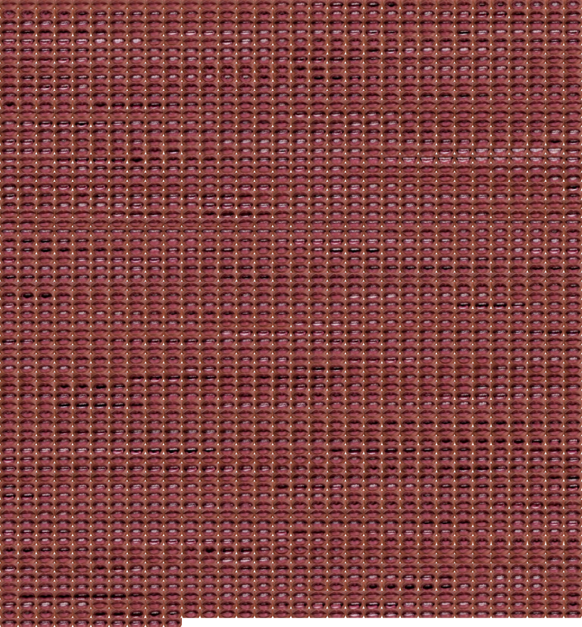
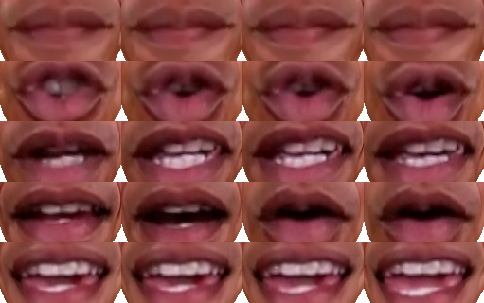
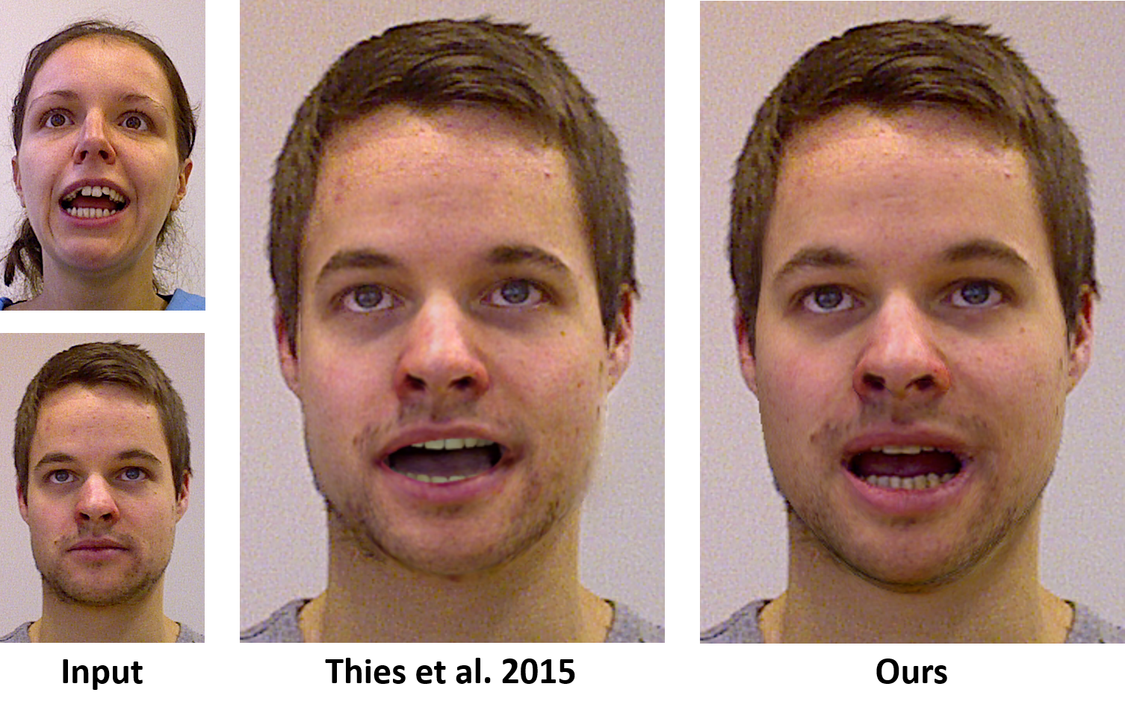
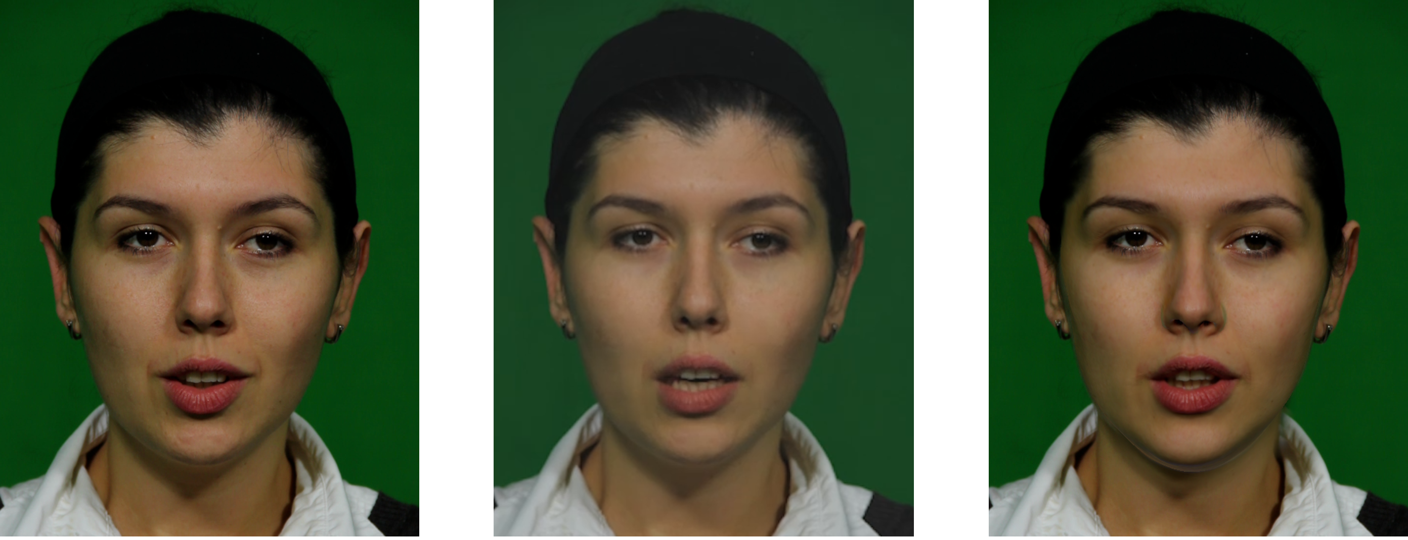
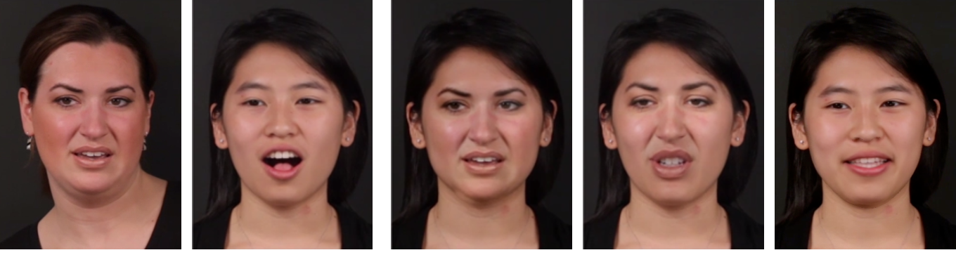
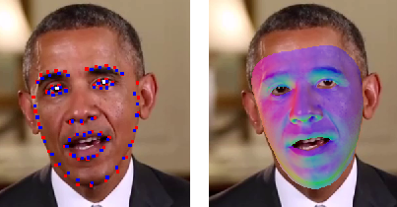
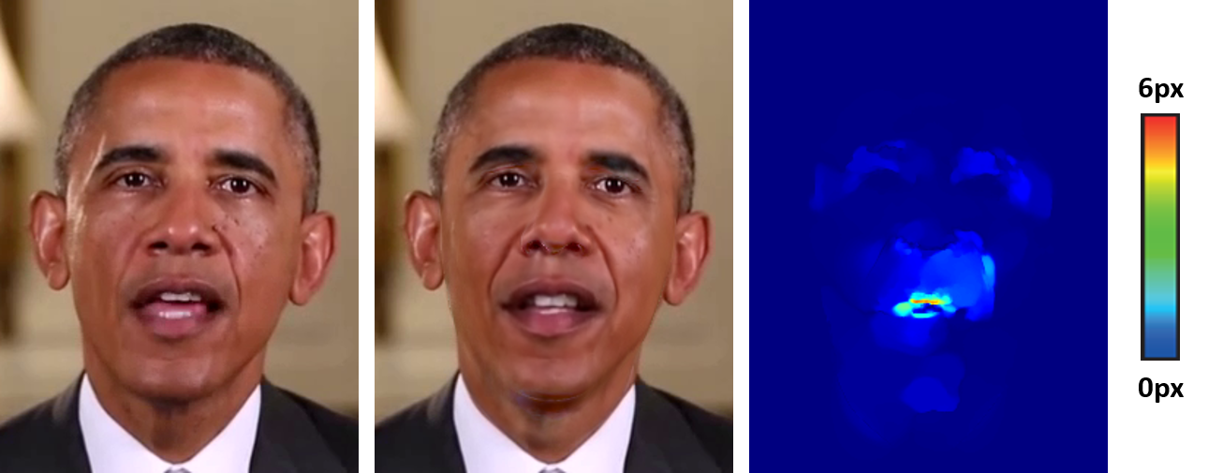
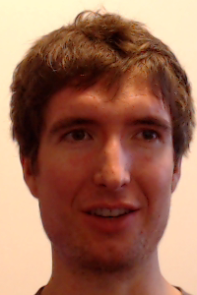
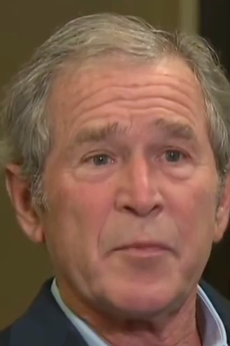
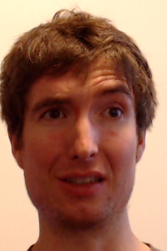
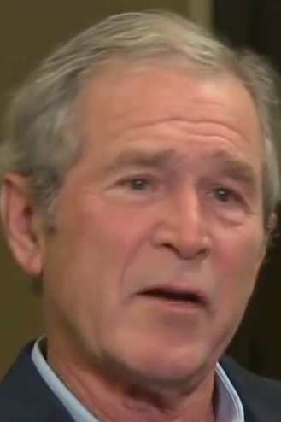
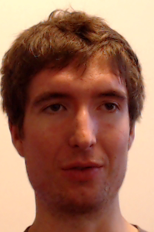
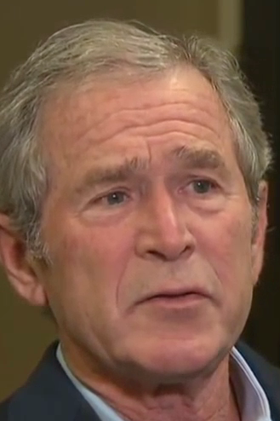
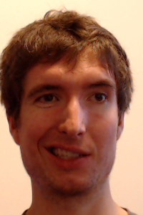
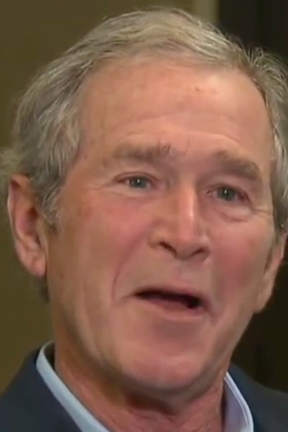
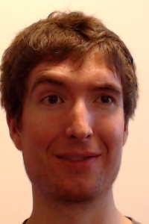
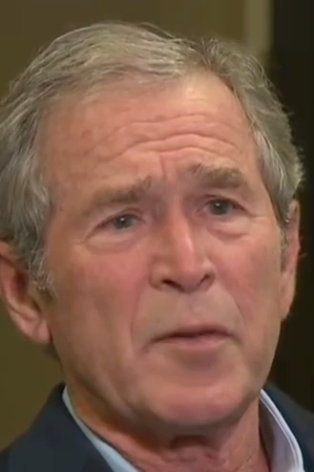
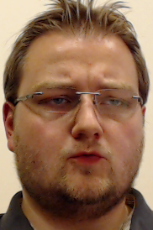
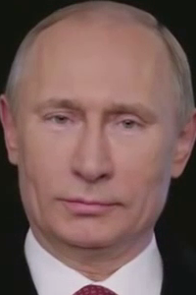
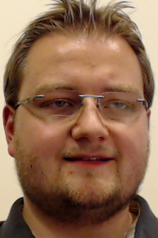
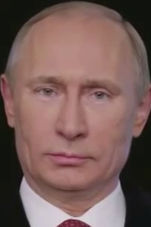
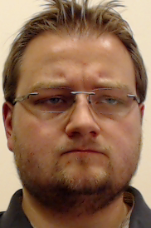
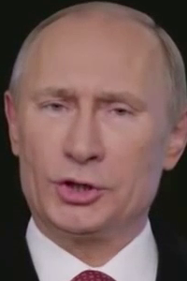
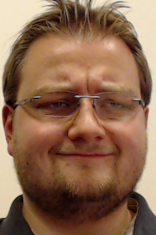
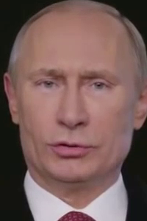
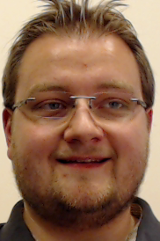
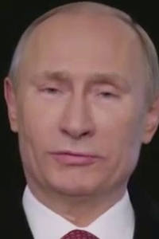
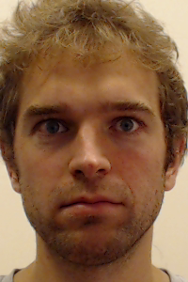
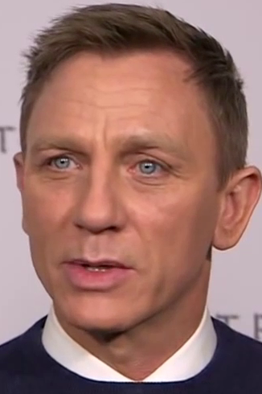
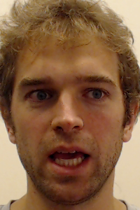
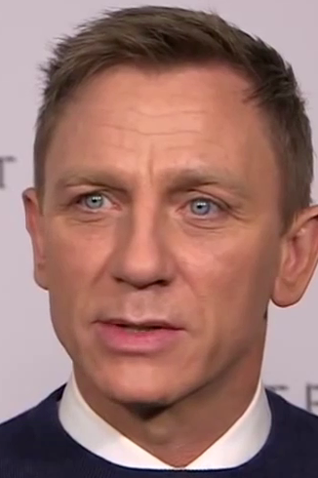
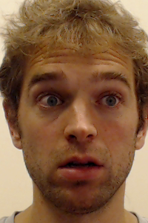
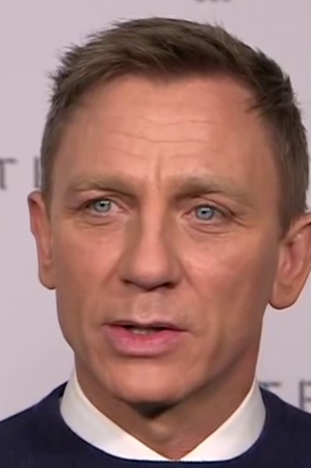
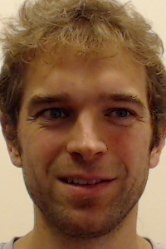
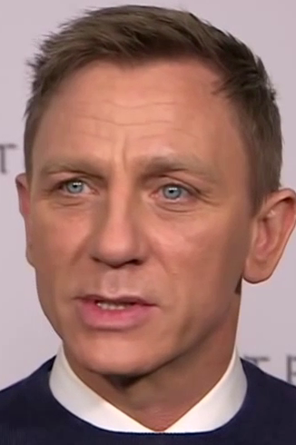





















Face2Face: Real-time Face Capture and Reenactment of RGB-Videos
Justus Thies¹, Michael Zollhöfer², Marc Stamminger¹, Christian Theobalt², Matthias Nießner³
¹University of Erlangen-Nuremberg ²Max-Planck-Institute for Informatics ³Stanford University
Face Capture:
Parametric Face Model
  Tri-linear Face Model
  Spherical Harmonics (3-Bands)
Energy Formulation
Non-Rigid Model-Based Bundling
  Minimize energy for multiple frames in a joint optimization
  All frames share the same identity parameters
  Use a coarse-to-fine optimization scheme
Online – Tracking
  Use the estimated identity of the bundling step
  Optimize for light, rigid and expression parameters
Optimization Framework
  Data-parallel Iteratively Reweighted Least Squares solver based on the GPU-based Gauss-Newton framework of Thies et al. 2015.
Reenactment:
Expression Transfer
  Solve the deformation transfer energy of Sumner et al. 2004 in the subspace of the blendshape model
Mouth Retrieval
  Find frame in the recorded video that best matches the transferred expressions
  The used similarity metric is based on the estimated face parameters and the photometric similarity (LBP + cross-correlation)
  To reduce the computational costs we first find the best fitting target mouth frame based on a frame-to-cluster matching strategy. We improve temporal coherence by using a dense appearance graph to find a compromise between the last retrieved frame and the target mouth frame.
  On the right you can see a cross-validation result in the self-reenactment scenario
Comparisons:
Tracking
  Our tracking results compete with state-of-the-art online and offline face tracking methods
Reenactment
  Our real-time system achieves comparable results as previous reenactment methods
References
[Sumner et al. 2004] R. W. Sumner and J. Popovic. Deformation transfer for triangle meshes. ACM TOG, 23(3):399–405, 2004.
[Dale et al. 2011] K. Dale, K. Sunkavalli, M. K. Johnson, D. Vlasic, W. Matusik, and H. Pfister. Video face replacement. ACM TOG, 30(6):130, 2011.
[Shi et al. 2014] F. Shi, H.-T. Wu, X. Tong, and J. Chai. Automatic acquisition of high-fidelity facial performances using monocular videos. ACM TOG, 33(6):222, 2014.
[Cao et al. 2014] C. Cao, Q. Hou, and K. Zhou. Displaced dynamic expression regression for real-time facial tracking and animation. ACM TOG, 33(4):43, 2014.
[Garrido et al. 2014] P. Garrido, L. Valgaerts, O. Rehmsen, T. Thormaehlen, P. Perez, and C. Theobalt. Automatic face reenactment. In Proc. CVPR, 2014.
[Thies et al. 2015] J. Thies, M. Zollhofer, M. Nießner, L. Valgaerts, M. Stamminger, and C. Theobalt. Real-time expression transfer for facial reenactment. ACM TOG, 34(6), 2015.
$$α$$
$$δ$$
$$β$$
Input
$$E\left(δ^{T}\right)= \sum_{i=1}^{\left|F\right|}{{\left\|A_{i}V_{i}−\hat{V_{i}}(δ^{T})\right\|}_{F}^{2}}→min$$
Output
Input Thies et al. 2015 Ours
Input Garrido et al. 2014 Ours
Input Dale et al. 2011 Garrido et al. 2014 Ours
Input
Input
Input
Reenactment
Reenactment
Reenactment

