Slide 1
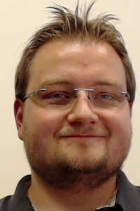
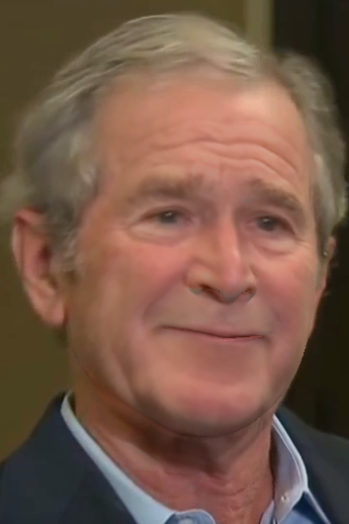
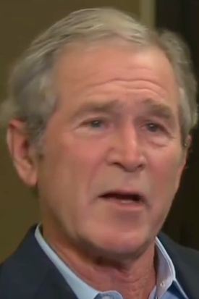
Face2Face: Real-time Face Capture and Reenactment of RGB-Videos
Justus Thies¹, Michael Zollhöfer², Marc Stamminger¹, Christian Theobalt², Matthias Nießner³
¹University of Erlangen-Nuremberg
²Max-Planck-Institute for Informatics
³Stanford University

Slide 2
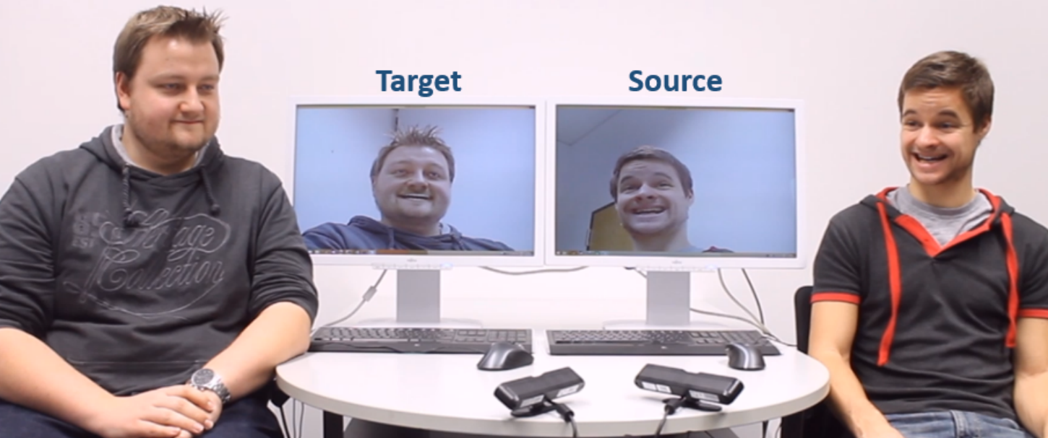
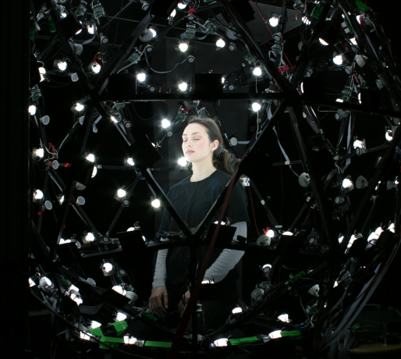
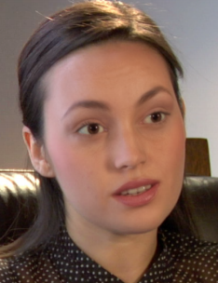
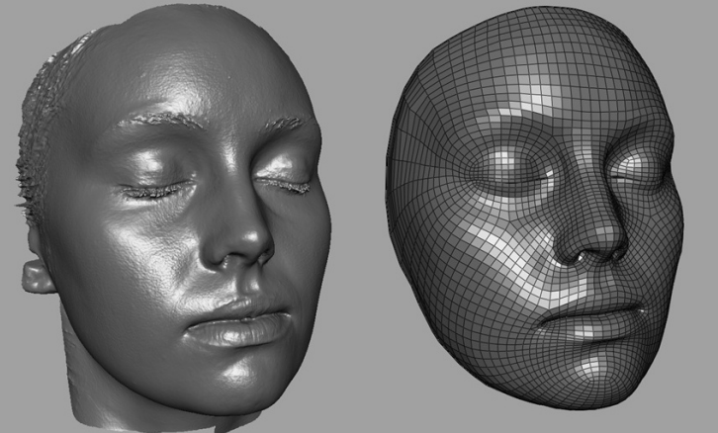
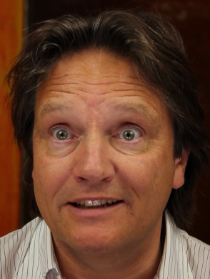
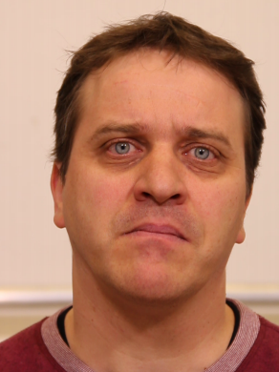
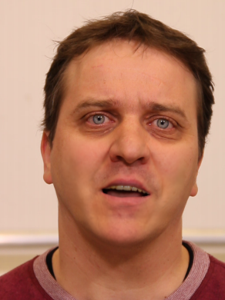
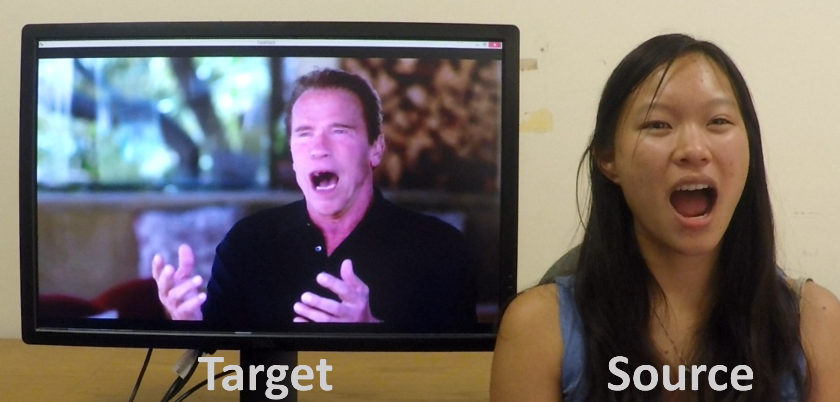
Related Work
Offline
Online
Creating a Photoreal Digital Actor:
The Digital Emily Project
Real-time Expression Transfer for Facial Reenactment
RGB-D
Special Hardware
Vdub: Modifying Face Video of Actors for
Plausible Visual Alignment to a Dubbed Audio Track
Face2Face: Real-time Face Capture and Reenactment
Of RGB-Videos
RGB

Slide 3
Related Work
Offline
Online
Creating a Photoreal Digital Actor:
The Digital Emily Project
Real-time Expression Transfer for Facial Reenactment
RGB-D
Special Hardware
Vdub: Modifying Face Video of Actors for
Plausible Visual Alignment to a Dubbed Audio Track
Face2Face: Real-time Face Capture and Reenactment
Of RGB-Videos
RGB

Slide 4
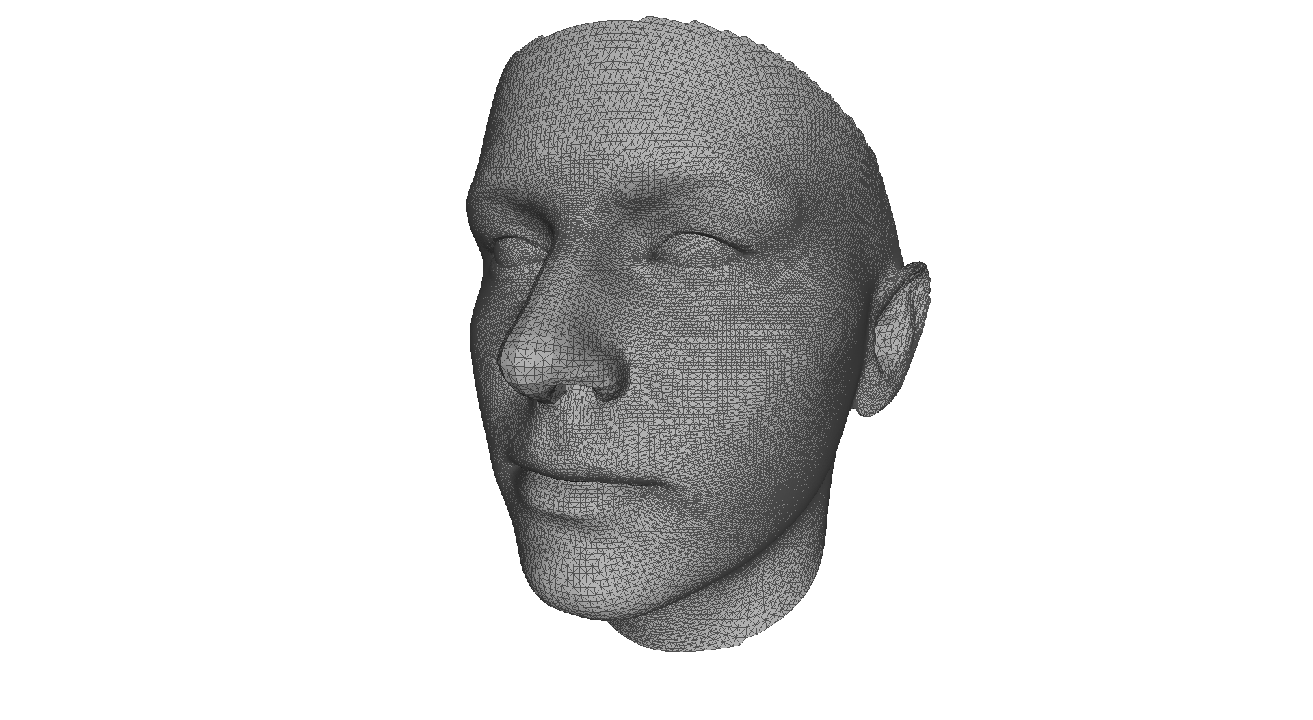
Overview
Parametric Face Model

Slide 5
Overview
Parametric Face Model
Face Capture
Non-rigid Model-based Bundling

Slide 6
Overview
Parametric Face Model
Face Capture
Non-rigid Model-based Bundling
Reenactment
Mouth Retrieval
Comparisons

Slide 7
Overview
Parametric Face Model
Face Capture
Non-rigid Model-based Bundling
Reenactment
Mouth Retrieval
Comparisons
Results / Live Demo

Slide 8
Parametric Face Model

Slide 9
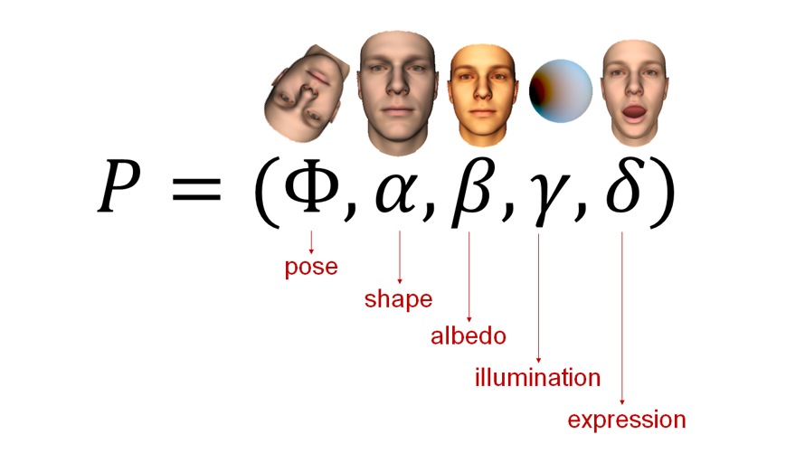
Parametric Face Model
$$P$$

Slide 10
Parametric Face Model
$$P=\left(\begin{matrix}Φ \\ \begin{aligned}α \\ β \\ δ\end{aligned} \\ γ\end{matrix}\right)$$
$$\left|P\right|=6$$

Slide 11
Parametric Face Model
$$P=\left(\begin{matrix}Φ \\ \begin{aligned}α \\ β \\ δ\end{aligned} \\ γ\end{matrix}\right)$$
$$\left|P\right|=6$$
$\left|P\right|=6$+80

Slide 12
Parametric Face Model
$$P=\left(\begin{matrix}Φ \\ \begin{aligned}α \\ β \\ δ\end{aligned} \\ γ\end{matrix}\right)$$
$\left|P\right|=6$+80
$\left|P\right|=6$+80+80

Slide 13
Parametric Face Model
$$P=\left(\begin{matrix}Φ \\ \begin{aligned}α \\ β \\ δ\end{aligned} \\ γ\end{matrix}\right)$$
$\left|P\right|=6$+80+80
$$\left|P\right|=6\text{+80+80+76}$$

Slide 14
Parametric Face Model
$$P=\left(\begin{matrix}Φ \\ \begin{aligned}α \\ β \\ δ\end{aligned} \\ γ\end{matrix}\right)$$
$\left|P\right|=6$+80+80+76
$$\left|P\right|=6\text{+80+80+76+2}\text{7}\text{=}\text{2}\text{69}$$

Slide 15
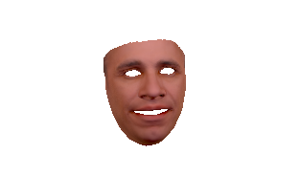
Parametric Face Model
$$P$$

Slide 16
Face Capture

Slide 17
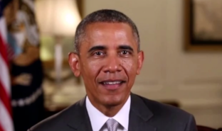
Energy Formulation
$$E\left(P\right)$$
$$=$$

Slide 18
Energy Formulation
$$E\left(P\right)$$
$$=E_{col}\left(P\right)$$
Distance in
RGB Color Space
Color
Consistency
$$l_{2,1}−norm$$

Slide 19
Energy Formulation
$$E\left(P\right)$$
$$=E_{col}\left(P\right)$$
$$+E_{mrk}\left(P\right)$$
Distance in
Image Space
Color
Consistency
Feature
Similarity

Slide 20
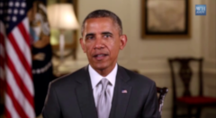
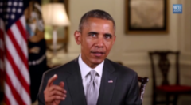
Non-rigid Model-based Bundling
$$E_{total}\left(P\right)=\sum_{i=0}^{n}{E_{i}\left(P\right)} →min$$

Slide 21
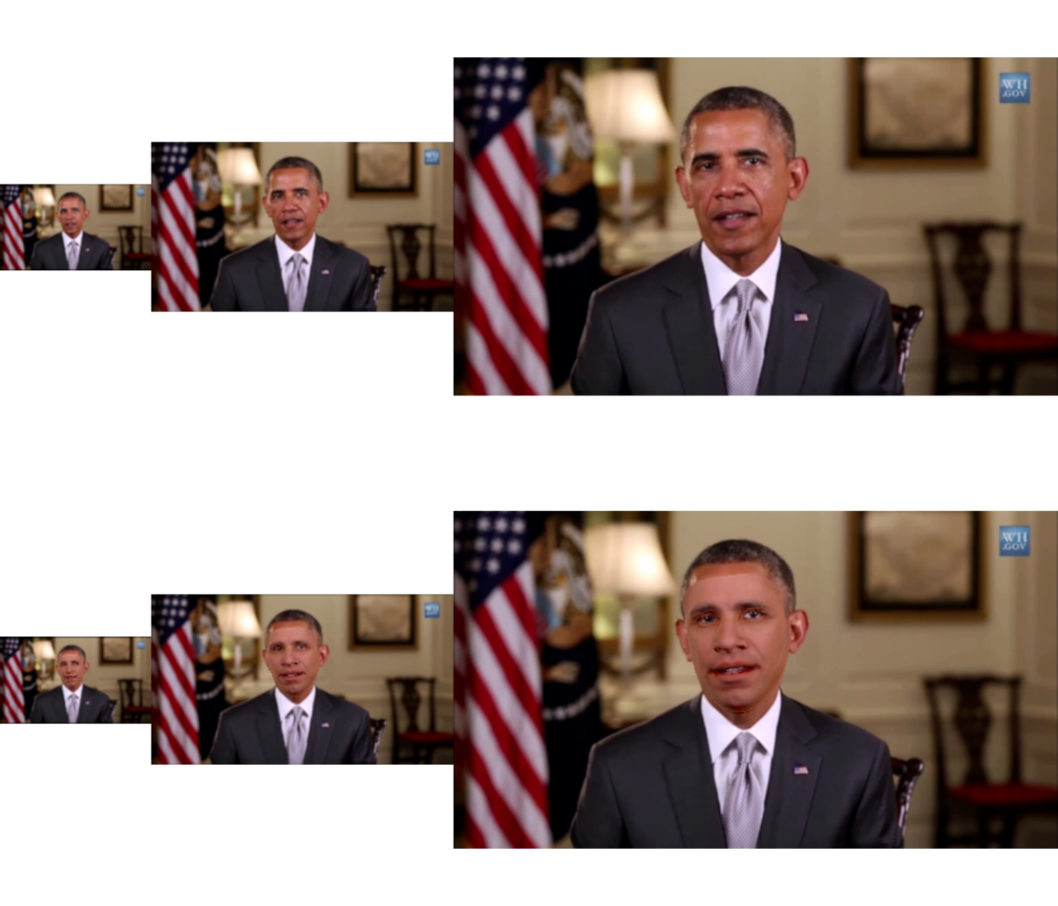
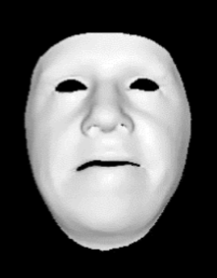
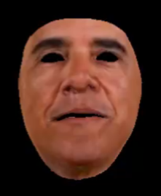
Non-rigid Model-based Bundling
Hierarchy Levels
Keyframes
Input
Model

Slide 22
Tracking

Slide 23
Reenactment

Slide 24
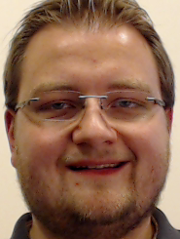
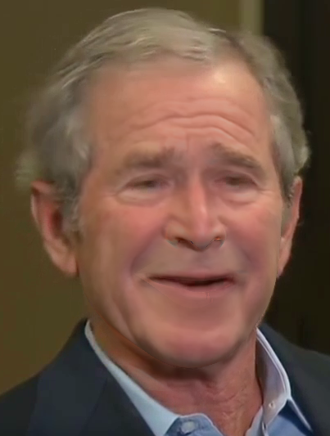
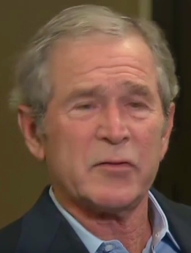
Reenactment
Online RGB-Tracking
Reenactment
Pose
Expression Transfer
Source Actor
Per Frame
Illumination
Expression
Mouth Retrieval
Identity
Compositing
Preprocessed Video Tracking
Pose
Target Actor
Per Frame
Illumination
Expression
Identity

Slide 25
Reenactment
Online RGB-Tracking
Reenactment
Pose
Expression Transfer
Source Actor
Per Frame
Illumination
Expression
Mouth Retrieval
Identity
Compositing
Preprocessed Video Tracking
Pose
Target Actor
Per Frame
Illumination
Expression
Identity

Slide 26
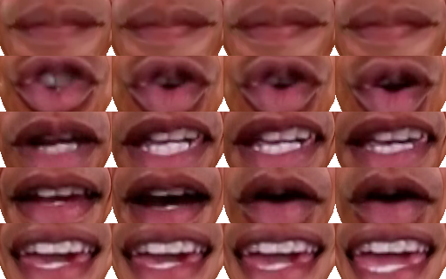
Mouth-Retrieval

Slide 27
Mouth-Retrieval

Slide 28
Reenactment Comparison

Slide 29
Live-Demo

Slide 30
Conclusion
First Real-time Facial Reenactment only based on RGB-videos
Non-Rigid Model-Based Bundling
Sub-Space Deformation Transfer
Image-Based Mouth Synthesis

Slide 31
Thank You!

